Slide 1


Journey to RabbitMQ
Michael Alberhasky| ITS-AIS
Sept 20, 2018

Slide 2

A long time ago…
ActiveMQ Adoption
First phase: October 2016
Second phase: March 2017

Slide 3
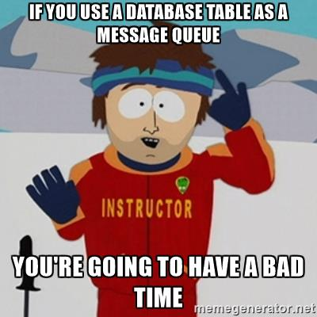
MAUI has queuing needs too
MAUI has a big ‘ol table for its “queue”
Hibernate hook inserts records into table
Polling process rather than any smart notifications
2.7 million rows causes contention issues

Slide 4
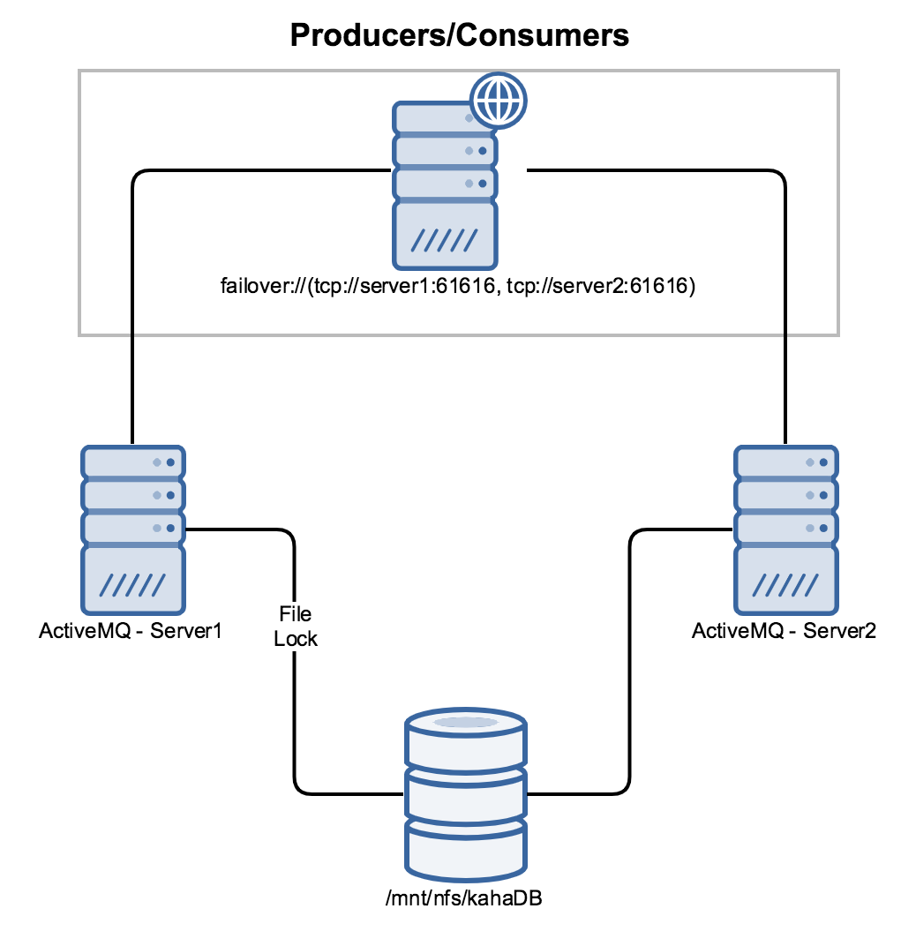
ActiveMQ – Resiliency?
Mature solution
Need to move from single node to a cluster
Clustering solution not ideal

Slide 5
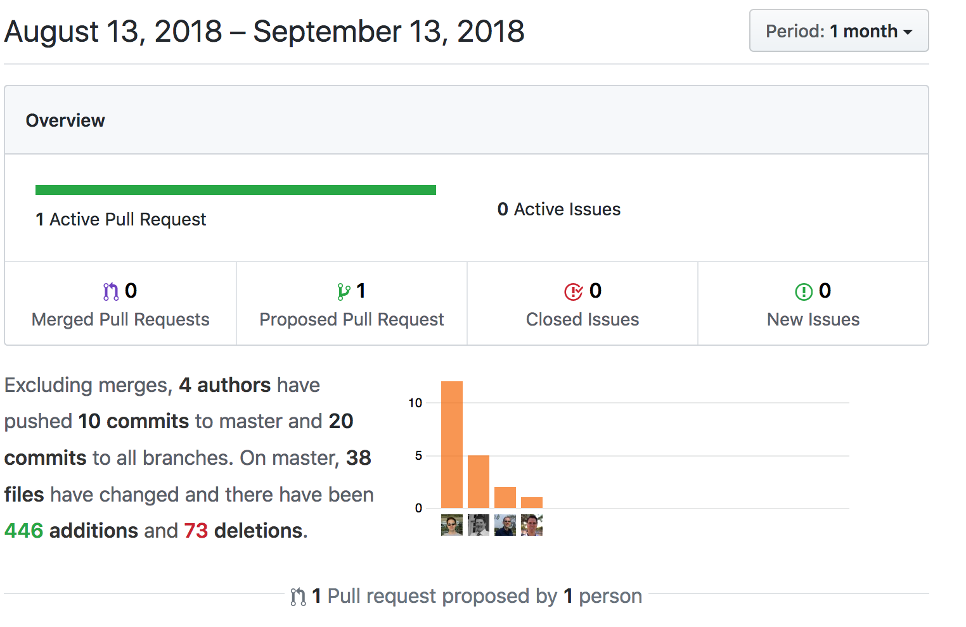
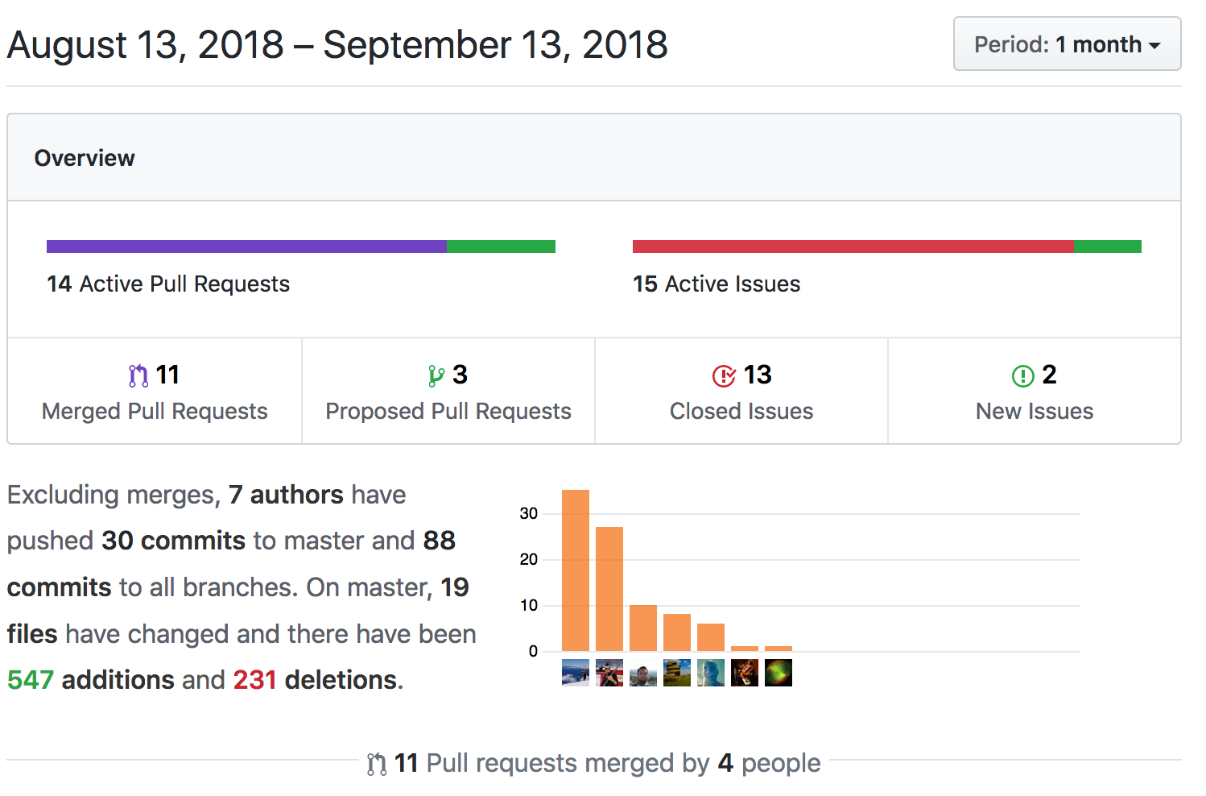
ActiveMQ – Past its expiration date?
ActiveMQ Github Activity
RabbitMQ Github Activity

Slide 6

Moving on to RabbitMQ
General purchase message broker
Runs on Erlang
Supports AMQP
DNA already testing
On-prem vs AWS

Slide 7
RabbitMQ on AWS
Deployment – everything is code
Clustering is much easier
Security and SSL
Performance
Policies, VirtualHosts, Exchanges
Elasticity

Slide 8
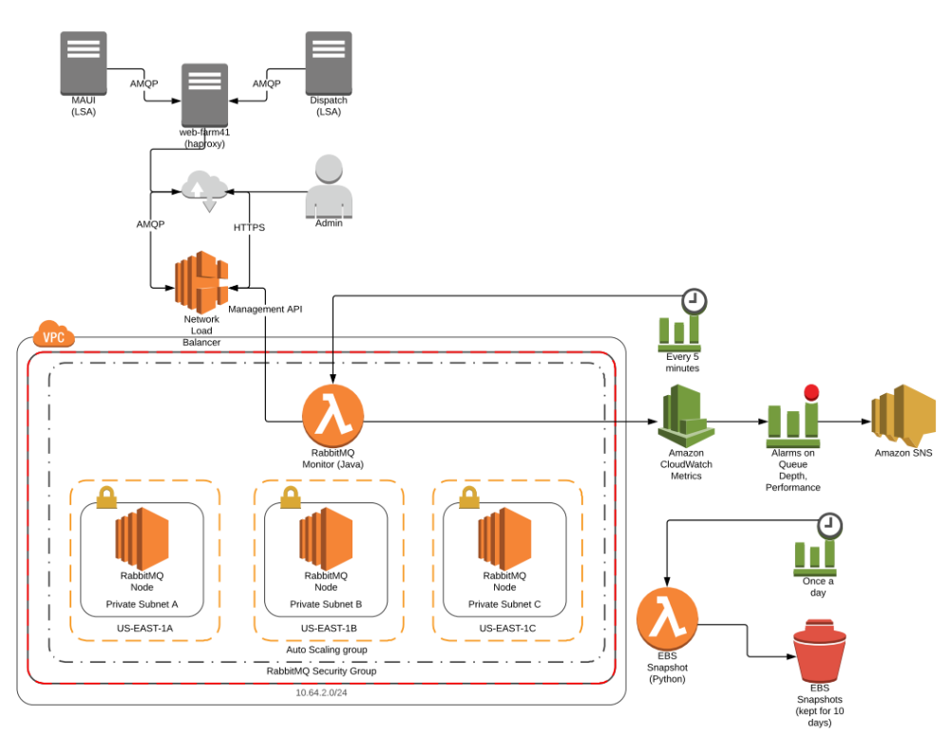
RabbitMQ Architecture

Slide 9
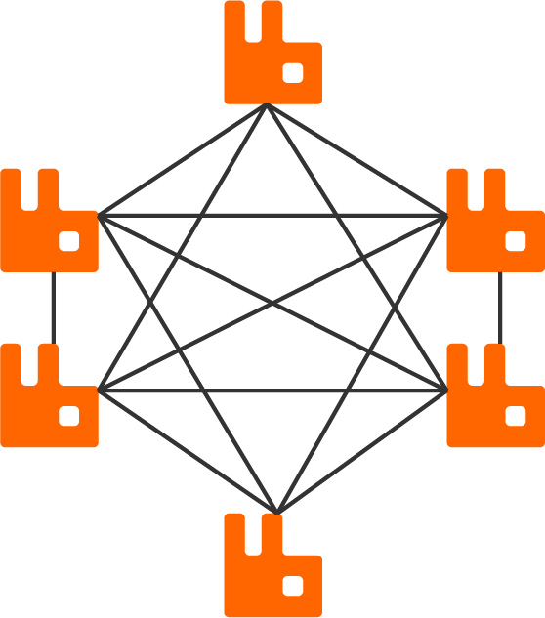
Clustering
Auto-discovery of peer by looking at membership in Autoscaling groups
Nodes automatically share configuration with each other
Queues live on one node but mirror to other nodes for high-availability
Leverages native Erlang clustering and communication

Slide 10

Security
SSL/TLS terminated on nodes
Security groups tightly restrict access
No VPN yet so no AD integration
Accounts scoped to VirtualHosts
No need to restart for security changes

Slide 11
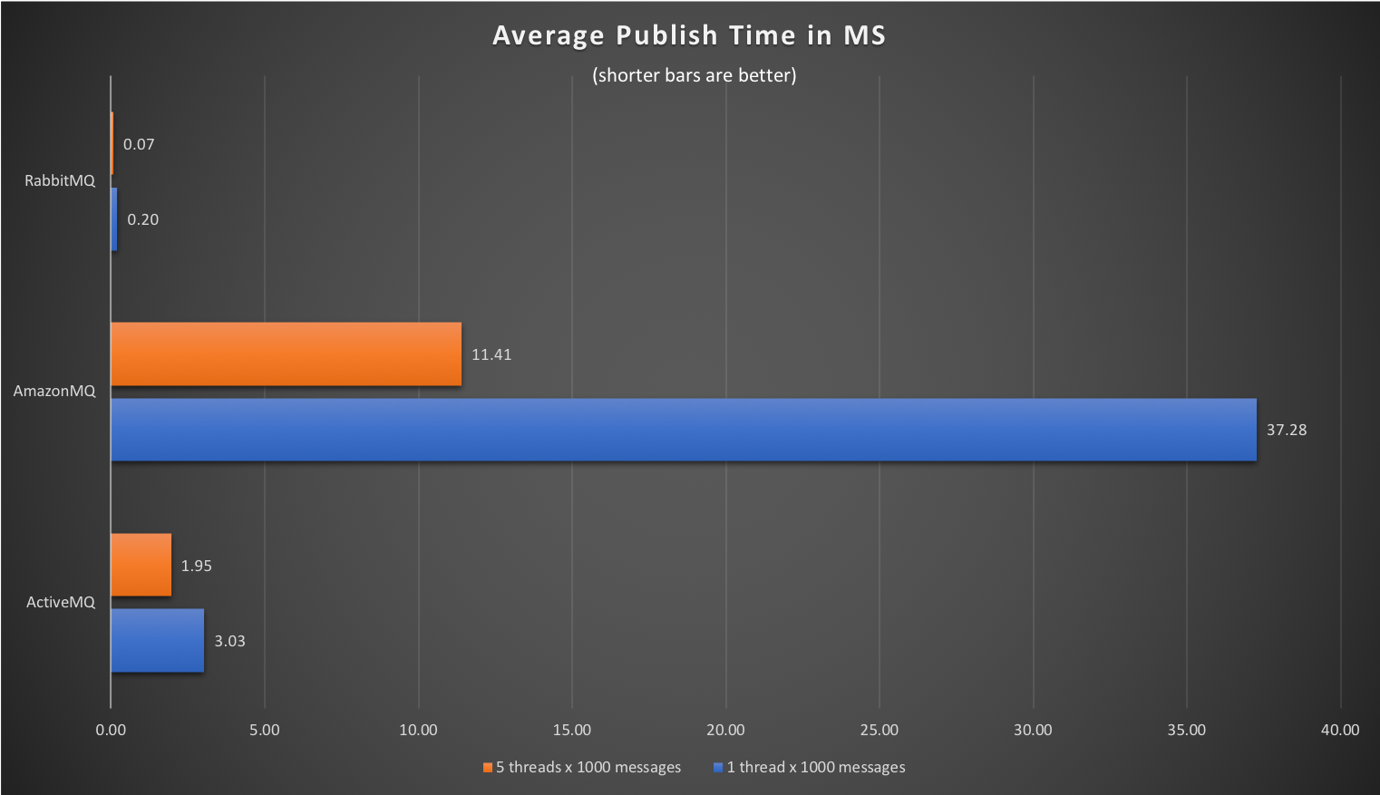
Let’s race!

Slide 12
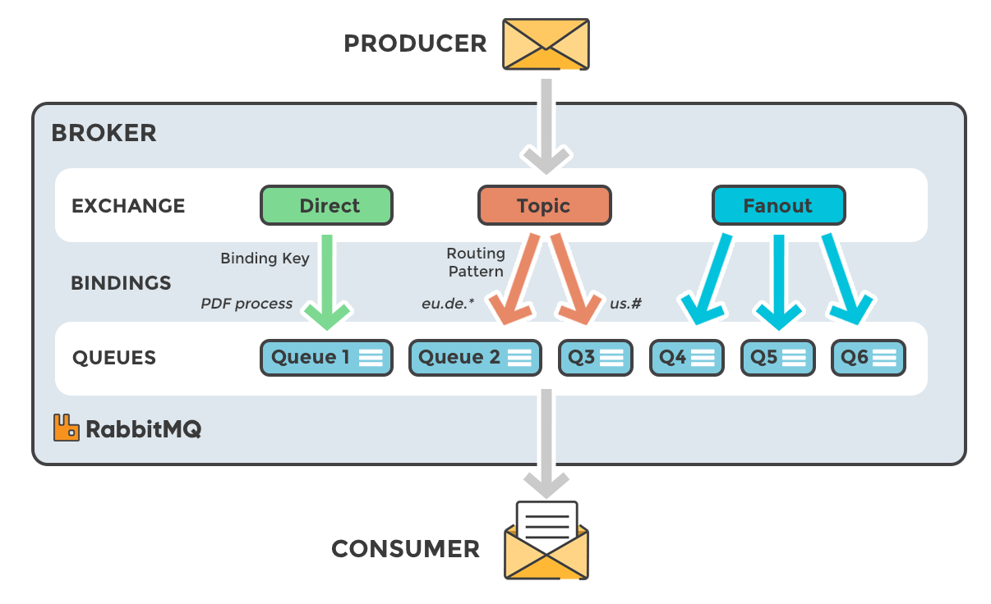
Exchanges, VirtualHosts, Policies

Slide 13
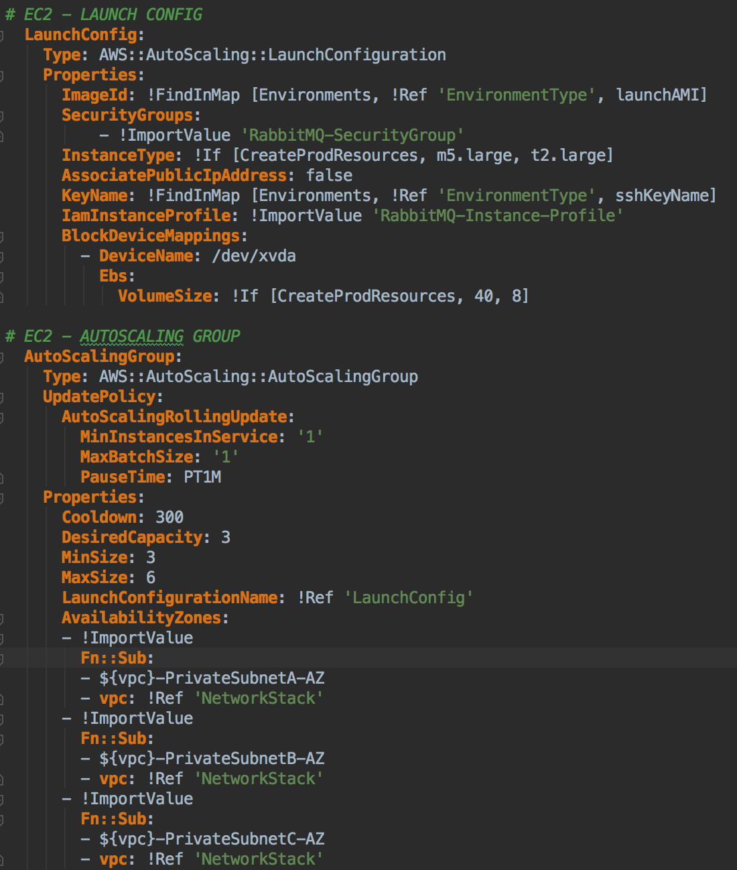
Elastic
Infrastructure as code – easy to launch new clusters
Auto-scaling
Easy to change machine characteristics
Blue/Green upgrades

Slide 14
Cons of RabbitMQ
No VPN to AWS yet – have to use a reverse proxy
Restarts of machines can place all queues on one node – need to rebalance
Delayed messages not native – need plugin
Erlang is not Java – just not familiar

Slide 15
Switching Dispatch

Slide 16
uiowa-rabbitmq Library
Convenience library to make publishing and consuming queues hopefully easy.
RabbitMQ mq = getInstance();
return mq.publish(queue, message, delay, true);

Slide 17
Queue layout change
dispatch.send.bulk.admissions.marketing
dispatch.send.bulk.uihc.marketing
dispatch.send.bulk.osc
dispatch.send.bulk.hawkeyecaucus
send.bulk

Slide 18
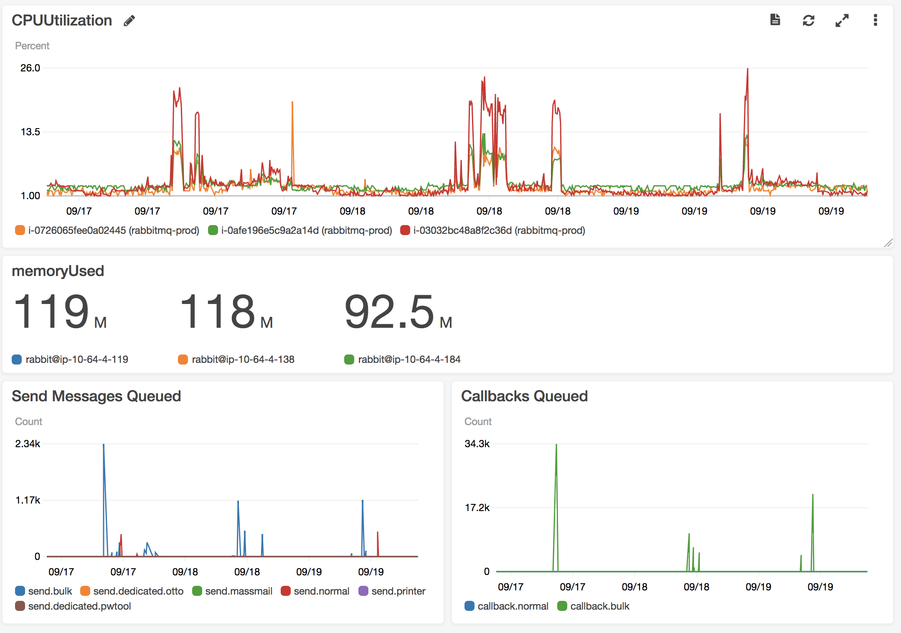
Metrics and alarms

Slide 19
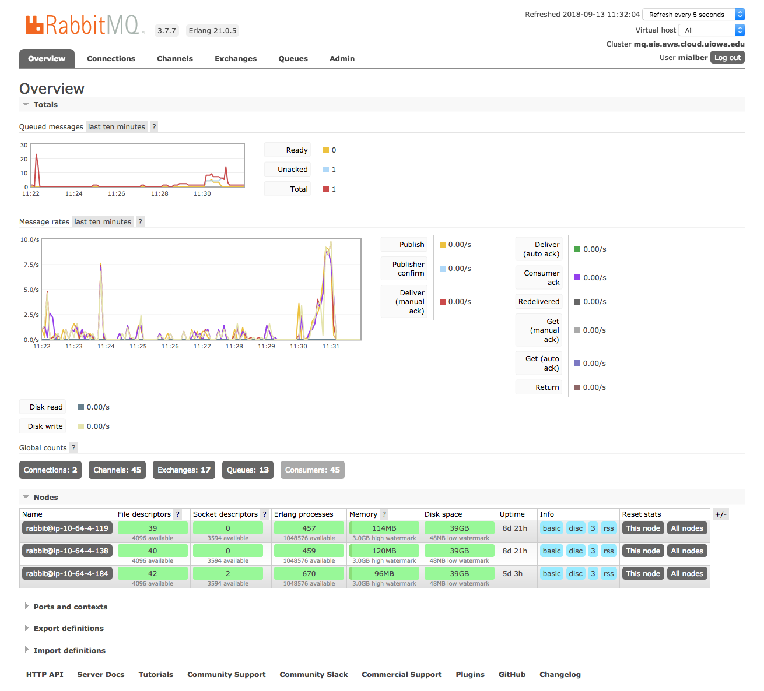
Better management tools

Slide 20
Questions?
Michael Alberhasky
michael-alberhasky@uiowa.edu

